Slide 1


Leveraging AI in the Workplace
AI is transforming how we work across industries. Tools like GitHub Copilot are being adopted at a rapid pace. This presentation explores how to unlock new levels of productivity and creativity with AI.
by Alex Xiao

Slide 2




What Does "Leveraging AI" Mean?
Automate Tasks
Let AI handle repetitive work that drains your productivity.
Natural Language
Describe outcomes you want in plain English.
Higher-Level Thinking
Focus on solving complex problems, not mundane tasks.

Slide 3
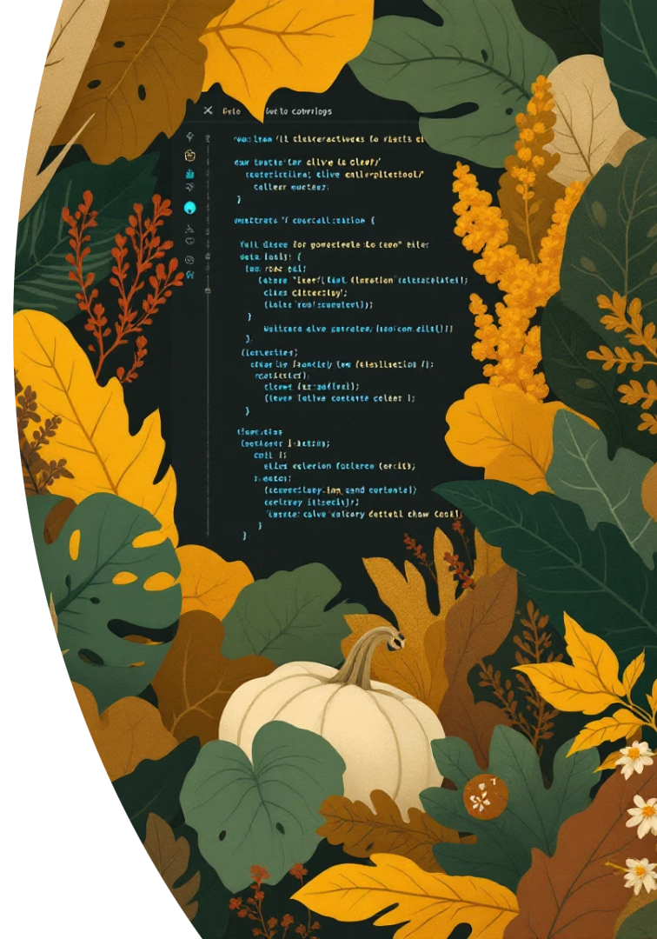



GitHub Copilot: An AI Assistant
Rapid Code Generation
Bug Fixing
Suggests fixes and helps refactor problematic code.
Creates working code and documentation in seconds.
Seamless Integration
Works directly within your favorite developer tools.

Slide 4

Writing Better Documentation With AI
First Draft Magic
Code Summarization
Copilot creates initial drafts of technical documentation quickly.
Automatically generates API references and explanations.
Time Savings
Reduces documentation time by 40% while improving consistency.

Slide 5






Code Generation: Fast and Reliable
Transformative Solutions
Turns problem descriptions into working code
Complete Structures
Suggests functions, classes, and multi-file changes
Practical Examples
Offers code snippets and algorithm implementations

Slide 6

Generating and Running Unit Tests
Test Stub Creation
Copilot proposes accurate unit test templates based on your code.
Automated Test Generation
Creates complete tests from function descriptions or requirements.
Instant Feedback Loop
Integrates with test frameworks for immediate validation.

Slide 7








The Power of Context: AI Works Better With Details
Specific Project Context
Live Code References
More detailed information leads to higher quality AI output.
Point AI to existing code patterns for consistency.
Guided Adaptation
Requirements Integration
AI adjusts suggestions based on your feedback.
Include business requirements for more accurate solutions.

Slide 8



Tips for Guiding AI Effectively
Positive Instructions
Tell AI what to do, not what to avoid
Task Breakdown
Split complex problems into manageable parts
Clear Prompts
Practice creating specific, actionable requests

Slide 9
Changing Your Mindset
Shifting from traditional coding to AI-assisted development requires a new perspective on problem solving.
Learning From Feedback
Collaborative Mindset
Iterative Refinement
Think of AI as a junior developer you're mentoring, not a perfect solution.
Analyze what works in your prompts to continuously improve results.
From Implementation to Direction
Start with a simple prompt, then guide AI with more specific details.
Focus on describing what you need instead of how to build it.

Slide 10
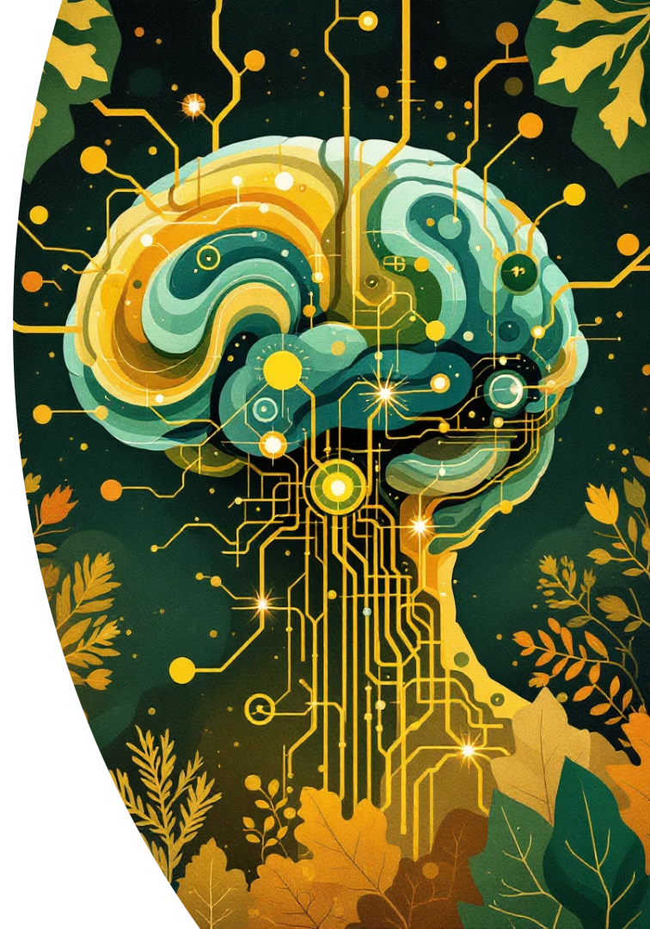
Changing Your Mindset
From Syntax to Questions
AI as Collaborator
Iterative Refinement
Shift from memorizing code to formulating good queries. Focus on problem framing rather than implementation details.
View AI as a team member, not just a tool. Engage in dialogue-like interactions for better results.
Provide feedback to improve outputs. Each interaction teaches you better prompt techniques.

Slide 11




Key Takeaways and Next Steps
Experiment
Test AI tools on different tasks to find best applications.
Shift Mindset
Approach problems thinking "How could AI help here?"
Continuous Learning
Adapt to evolving AI capabilities and tools.

